Slide 1
PARTICIPATORY LAND USE MODELING WITH CELLULAR AUTOMATA
Francisco Escobar
Dept of Geography
University of Alcalá
www.geogra.uah.es/patxi
francisco.escobar@uah.es

Slide 2
CONTENT
Land use
Modelling
Participation
Doñana National Park

Slide 3
LU
Land use is essential to society
Land use shapes our world (landscapes, products and resources)
Land use impacts on:
Environment
Demography
Policies
Socio-economic conditions
…
All of them impact on land use
Land use
Socio-economic
conditions

Slide 4
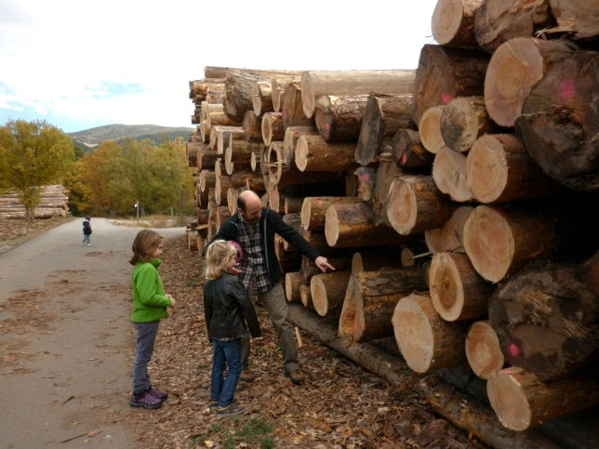
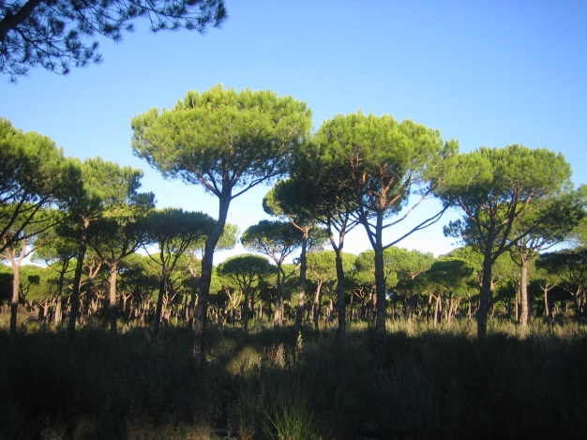
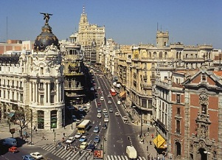
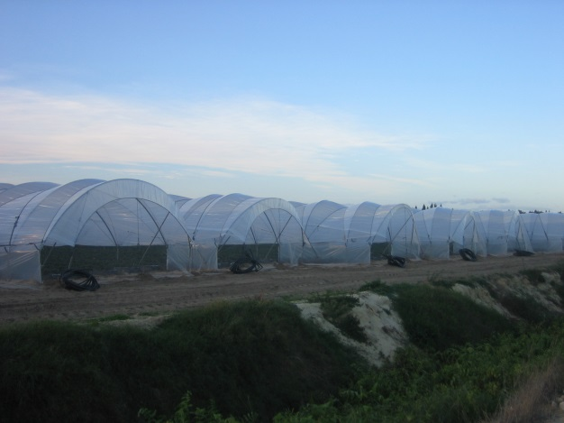
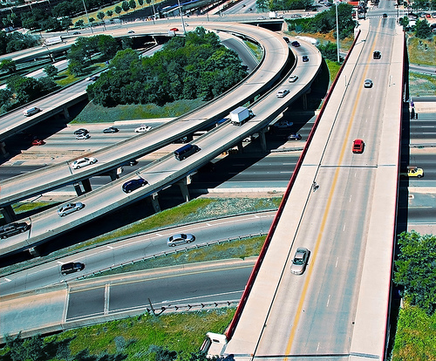
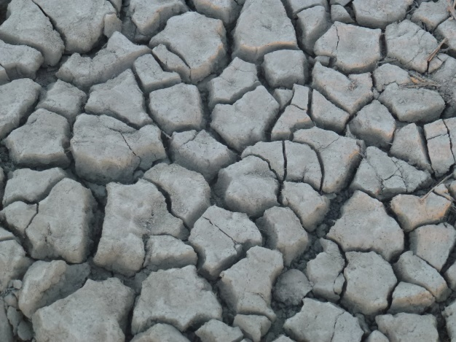
LU
Essential to society
Land use concerns the products and/or benefits obtained from use of the land as well as the land management actions (activities) carried out by humans to produce those products and benefits (FAO, 2013)
Natural land as services provider
Different visions on land use
Photo: swanksalot via Flickr

Slide 5
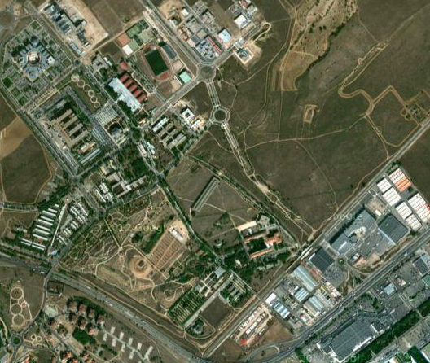
LU
Dealing with land use data - issues
Land use / land cover
Built
Green areas
Use: Educational/Research

Slide 6
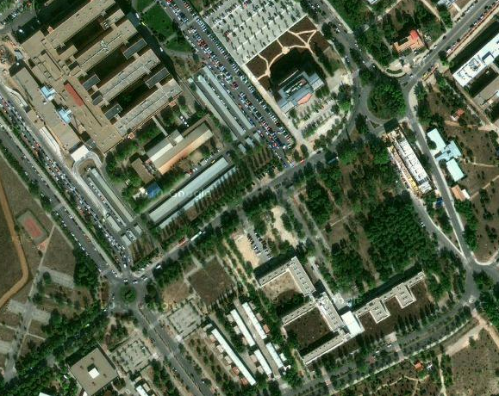
LU
Dealing with land use data - issues
Data quality (temporal, positional, thematic)
Documentation - metadata
Spatial scale and thematic resolution
Health
Educational
Recreational
Educational
Residential

Slide 7
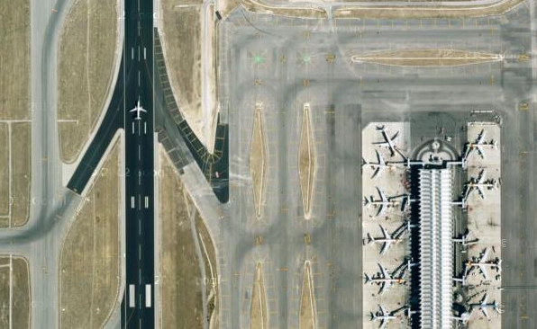
LU
Dealing with land use data - issues
Spatial scale and thematic resolution

Slide 8
LU
Dealing with land use data - issues
Different land use dynamics
Natural
Agricultural
Built
Issues on differentiating classes
Different pace of change
Total invariable; what one loses, the other one gains

Slide 9
Md
Why modelling?
Epstein’s 16 reasons to justify modelling (2008)
1. Explain (very distinct from predict)
2. Guide data collection
3. Illuminate core dynamics
4. Suggest dynamical analogies
5. Discover new questions
6. Promote a scientific habit of mind
7. Bound (bracket) outcomes to plausible ranges
8. Illuminate core uncertainties.
9. Offer crisis options in near-real time
10. Demonstrate tradeoffs / suggest efficiencies
11. Challenge the robustness of prevailing theory through perturbations
12. Expose prevailing wisdom as incompatible with available data
13. Train practitioners
14. Discipline the policy dialogue
15. Educate the general public
16 Reveal the apparently simple (complex) to be complex (simple)
none of these imply
“prediction”

Slide 10
Evolving techniques
Md
From static to dynamic modelling
Cartographic modelling
Agent-based modelling
Cellular automata-based modelling

Slide 11
ABOUT CELLULAR AUTOMATA (CA)
Md
Modelización de las dinámicas de los usos del suelo en la Red de Parques Nacionales Españoles y su entorno
Origin
What is it?
Cellular automata in geographic space
Cellular automata in land use modelling

Slide 12
ABOUT CELLULAR AUTOMATA (CA)
Md
Modelización de las dinámicas de los usos del suelo en la Red de Parques Nacionales Españoles y su entorno
Origins
Maths theory by Von Neuman y Ulman en 1940
First CA developed in 1970 by Conway – Game of life
Rejilla (grid) de celdas cuadradas, ortogonal, bi-dimensional e infinita
Dos estados posibles; vivo o muerto
Ocho vecinos
En pasos discretos ocurre la siguiente transición:
1. Cualquier celda viva con menos de 2 vecinos vivos muere (causa: bajo poblamiento).
2. Cualquier celda viva con 2 ó 3 vecinos vivos sobrevive hasta la siguiente generación.
3. Cualquier celda viva con más de 3 vecinos vivos muere (causa: superpoblación).
4. Cualquier celda muerta con exactamente 3 vecinos vivos revive (causa: reproducción).

Slide 13
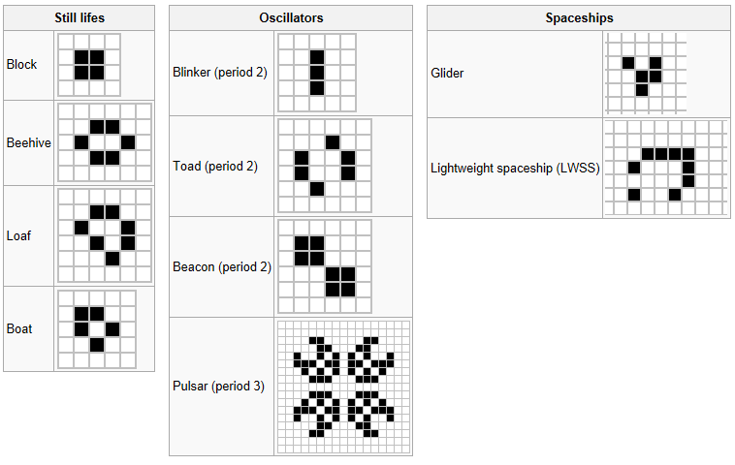
ABOUT CELLULAR AUTOMATA (CA)
Md
Modelización de las dinámicas de los usos del suelo en la Red de Parques Nacionales Españoles y su entorno
Game of life Conway (animaciones en wikipedia)

Slide 14
Md
ABOUT CELLULAR AUTOMATA (CA) – CA in Geography
1979 – Waldo TOBLER and his “Cellular Geography”
First Law of Geography: Todas las cosas están relacionadas entre sí, pero las cosas más próximas en el espacio tienen una relación mayor que las distantes
First in applying CA to land use
CA as a modelling tool for the simulation of processes spatially distributed (mainly and primarily urban models)
Batty y Longley, 1986; 1987; Clarke y Gaydos, 1998; White y Engelen, 1993; 2000; White et al, 1997; 1999

Slide 15
ABOUT CELLULAR AUTOMATA (CA) - definitions
Md
Sistema de celdas que interactúan de forma simple pero revelan comportamientos globales complejos (S. Wolfram, 1983; Couclelis, 1988)
Modelo matemático para un sistema dinámico que evoluciona en pasos discretos (formalizado en los años 40 por Stanislaw Ulam yJohn von Neumann)
Partiendo de reglas relativamente sencillas, los AC hacen emerger estructuras complejas (A. Langlois y M. Phipps, 1997)
Powerful models to understand spatial phenomena and processes
Models to simulate geographic space evolution

Slide 16
ABOUT CELLULAR AUTOMATA (CA) - characteristics
Md
Modelización de las dinámicas de los usos del suelo en la Red de Parques Nacionales Españoles y su entorno
Grid - cells
Each cell adopts a value among a finite number of states
Each cell is characterized by its vicinity
All cells are affected by a transition function (based on its own value and that of its neighbourhood)
A virtual clock is connected to each cell to indicate the moment in wich the transition function has to be applied.

Slide 17
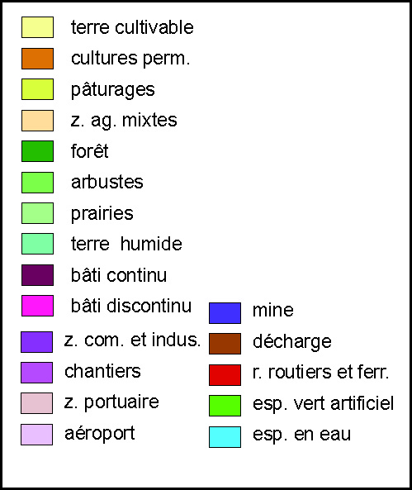
Md
Cells and vicinity
States
1 cell = 100 x 100 m

Slide 18
Md
Generic functions to establish distance rules
No interaction
Attraction
Repulsion
Change of interaction by distance
Strong interaction with distant neighbours
Attraction decay
Strong interaction with close neighbours
Influence sphere

Slide 19
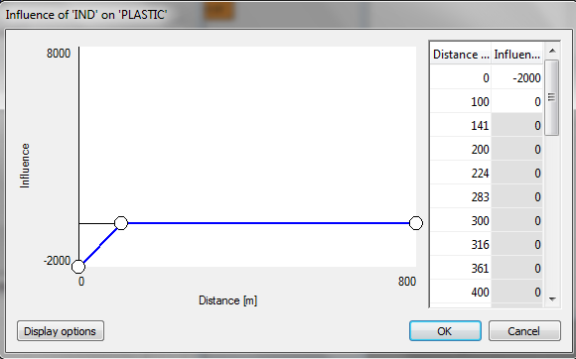
Md
Distance rules

Slide 20
CA and land use change
Md
Advantages
Weaknesses of traditional models
Adaptation to spatial systems
Decentralised approach
Affinity with GIS and Remote Sensing
Detailed scales
Simultaneous attention to space, time and attributes
Dynamic
Complex models
Simplicity
Visualization

Slide 21
The METRONAMICA model
Md
Developed by RIKS in partnership with JRC (European Commission)
From Murbandy to Moland and Metronamica

Slide 22
Graphic description – the NASZ model
Md
Land use
T1 and T2
Simulated land use
year 2035
Neighbourhood
effect
Transition
potential
Accessibility
Derived
products
Zoning status
Suitability

Slide 23
Md
Transition Potential determines the future state of each cell
TP is calculated as a function where a set of endogenous factors interact to update the state of the cell in every time step
These factors are:
- Neighourhood rules
- Accessibility
- Zoning
- Suitability
- Stochasticity

Slide 24
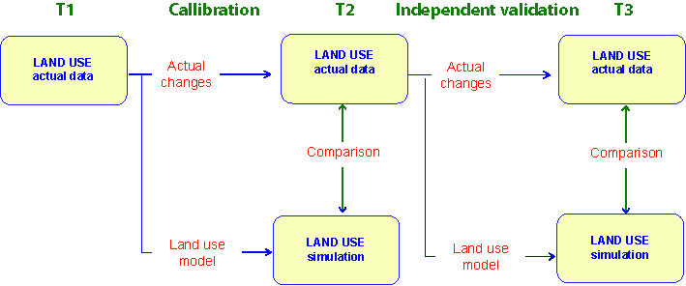
Model cycle
Md

Slide 25
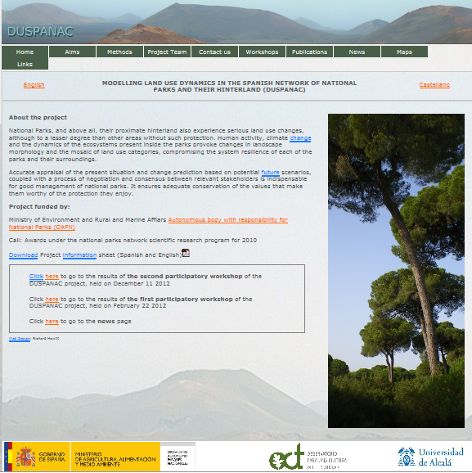
NP
Modelling land use dynamics in Doñana National Park and its hinterland
www.geogra.uah.es/duspanac

Slide 26
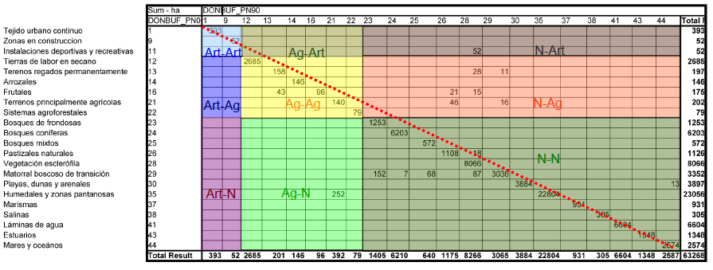
Why Doñana?
NP
Threats
Data availability
Relevance
Variety of land use classes

Slide 27
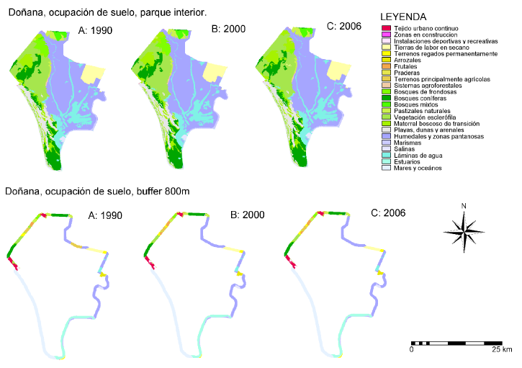
Doñana – land use changes 1990 – 2000 - 2006
NP

Slide 28
NP
Modelling natural protected areas land use
Doñana National Park
Challenges:
National park since 1969
Long calibration period – data needs
Profound conflicting interests

Slide 29
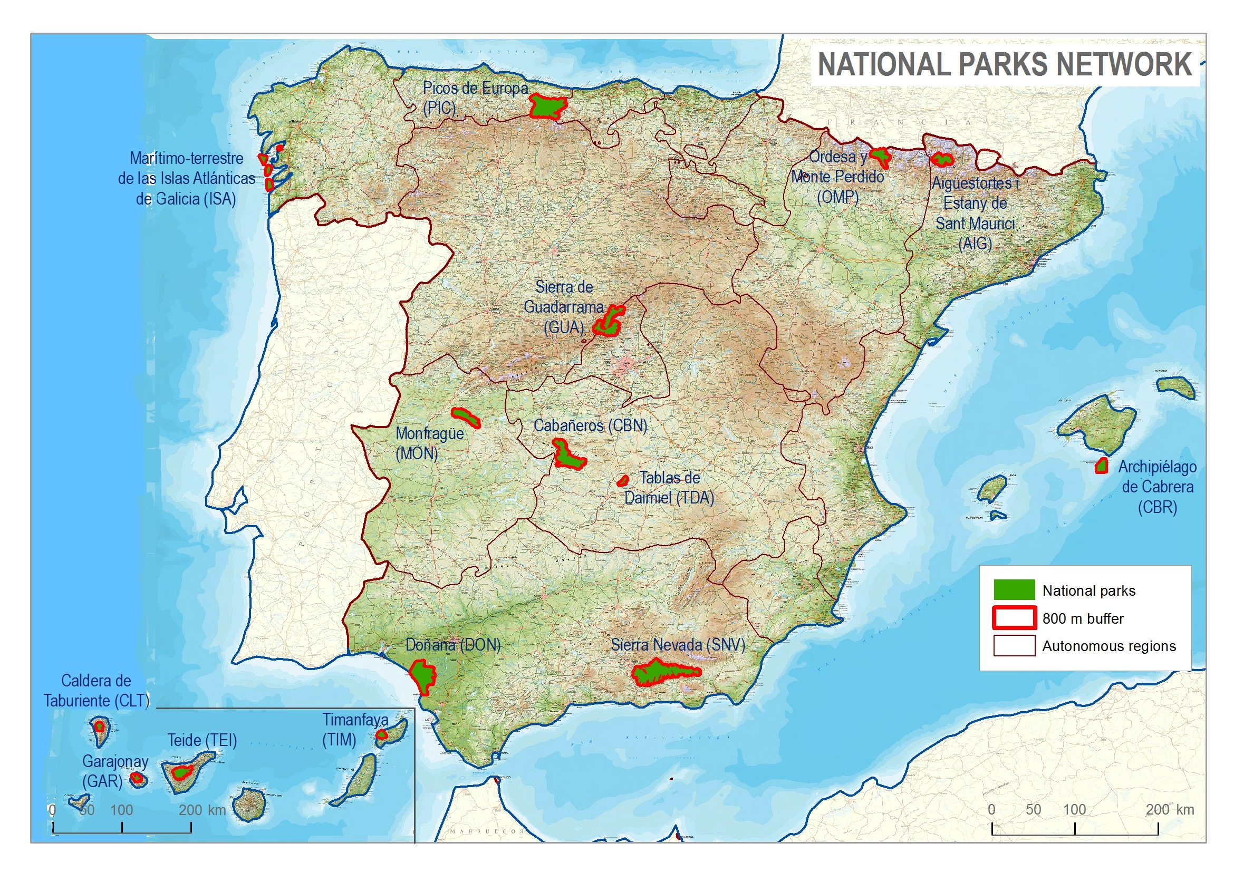
Doñana

Slide 30
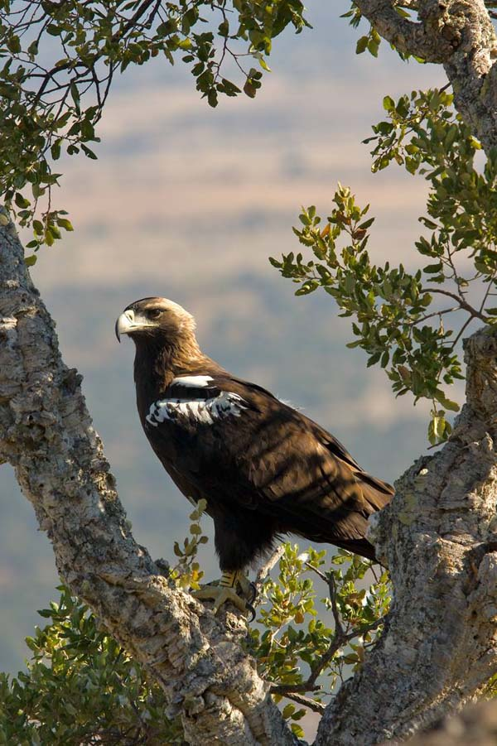
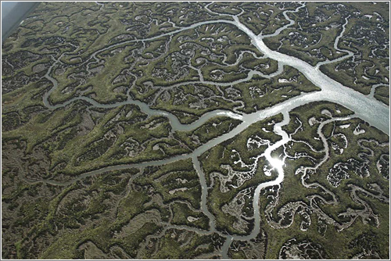
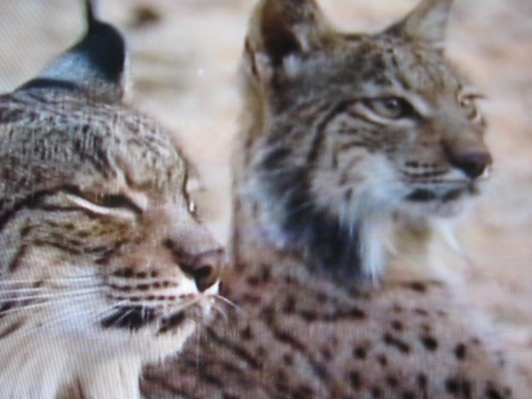
Doñana
NP
National Park area: > 50,000 ha
Modelling area: > 300,000 ha
Natural values:
Diverse ecosystems (marshes, coastal dunes,
Mediterranean forest, riparian formations)
Biodiversity
Emblematic species – Iberian Lynx, Imperial Iberian Eagle
Cultural values

Slide 31
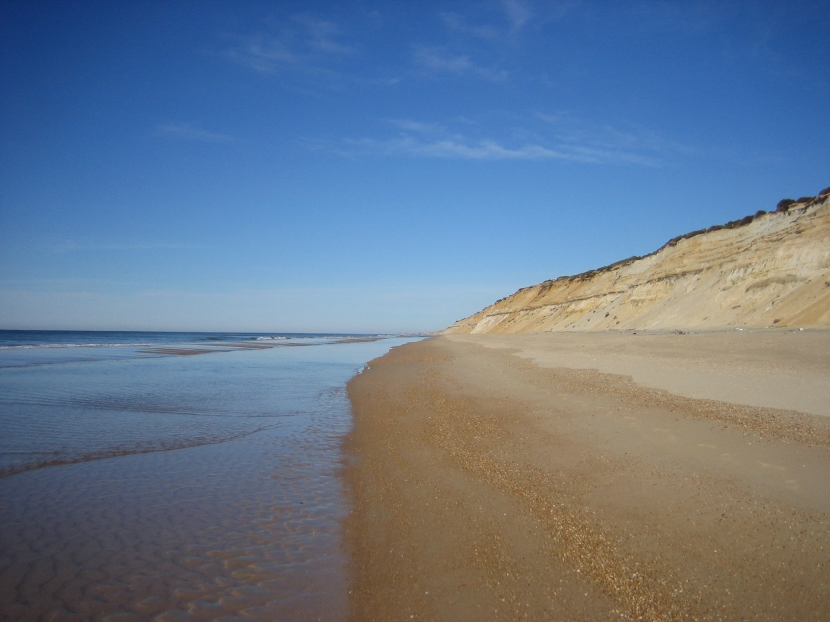
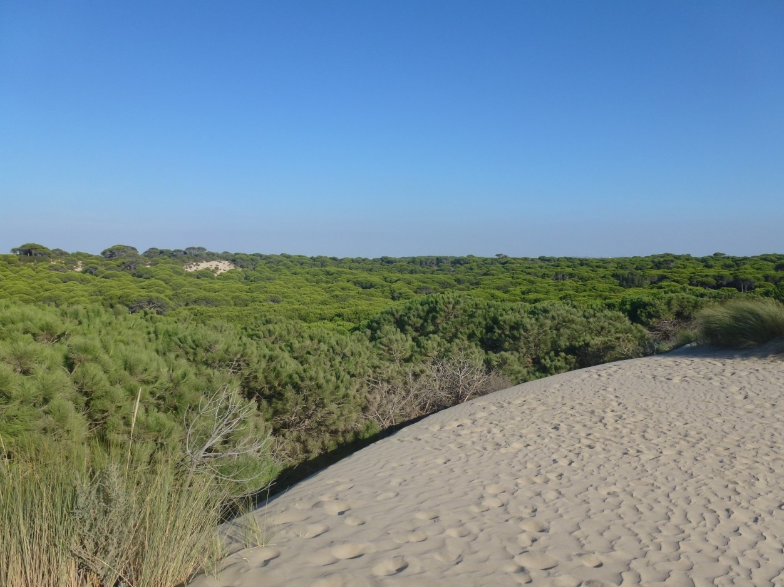
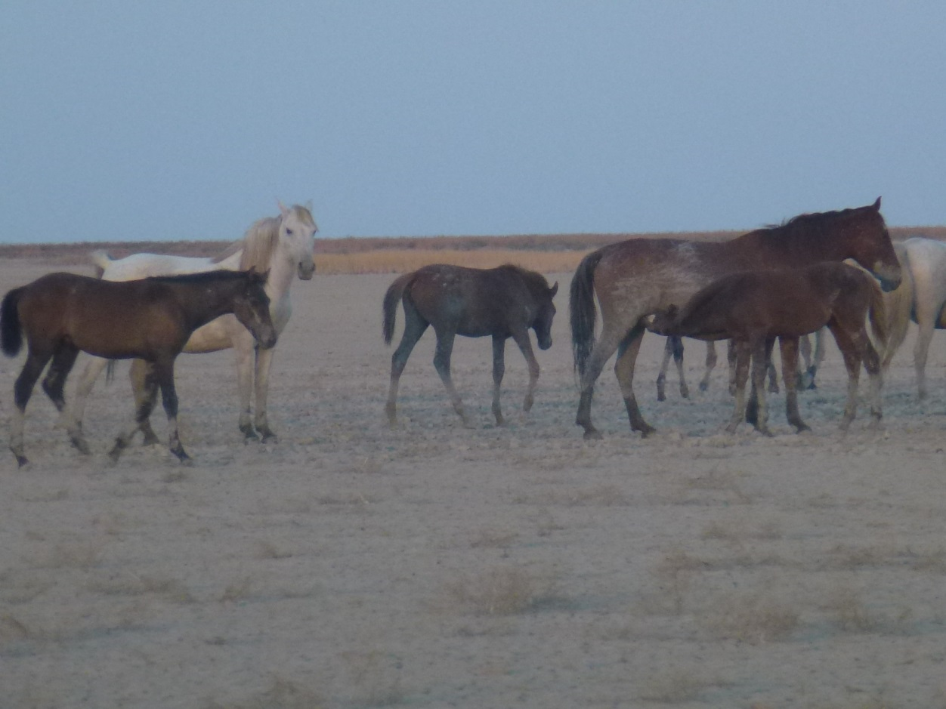

Slide 32
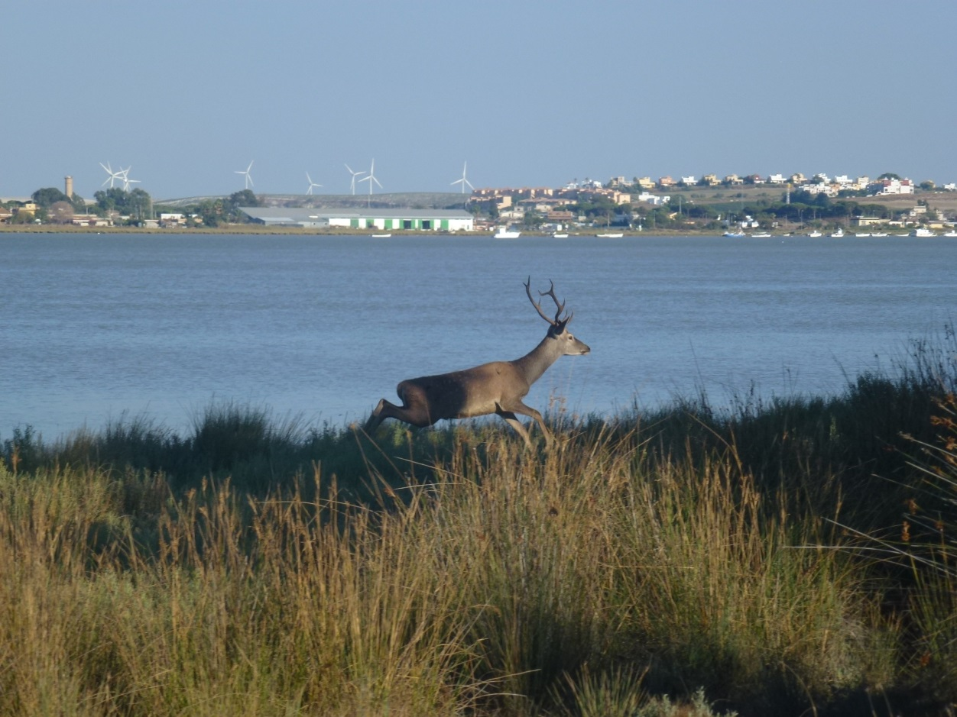
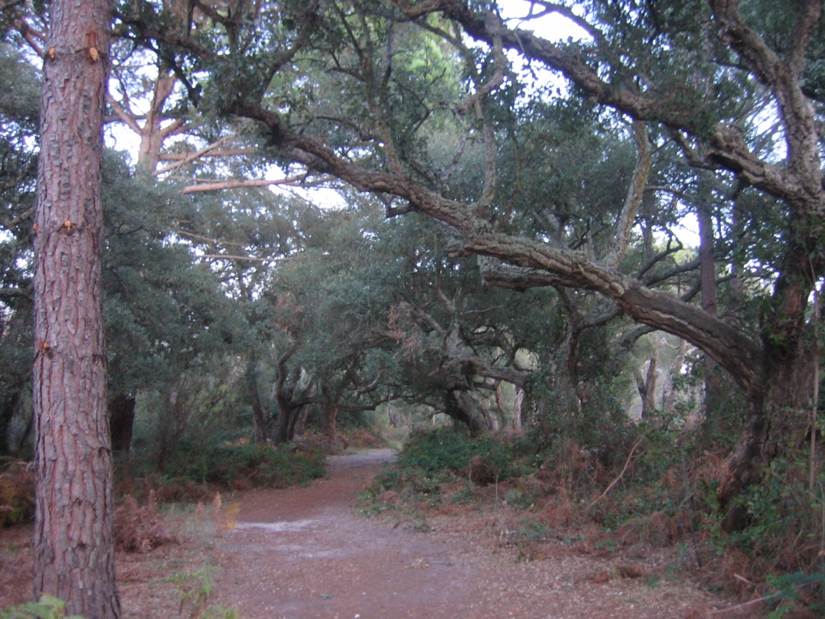
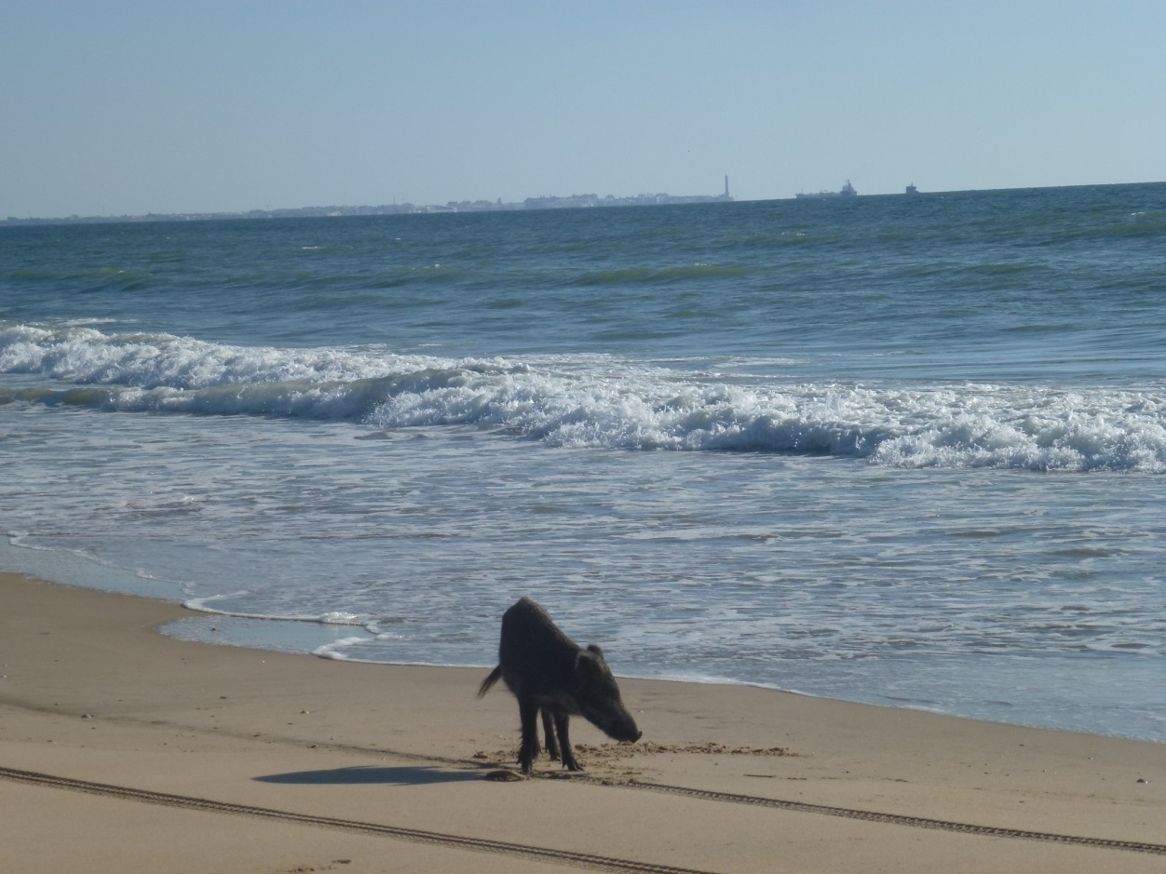
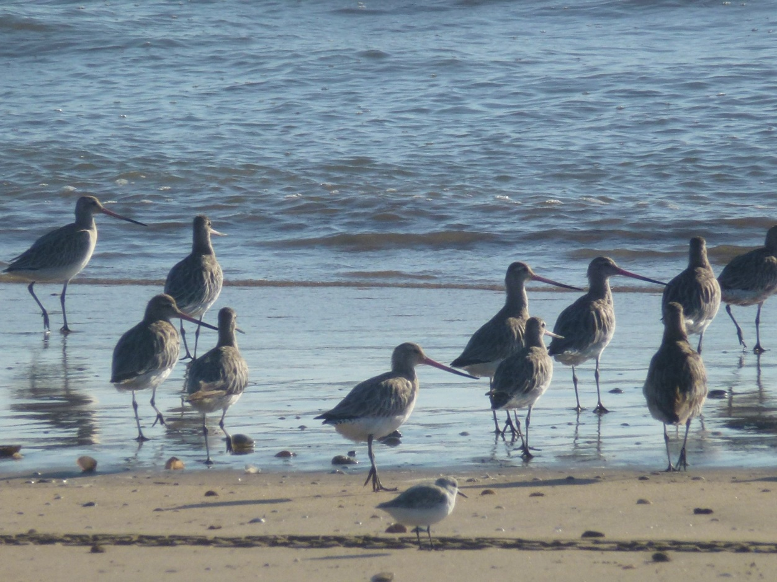

Slide 33
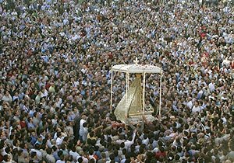
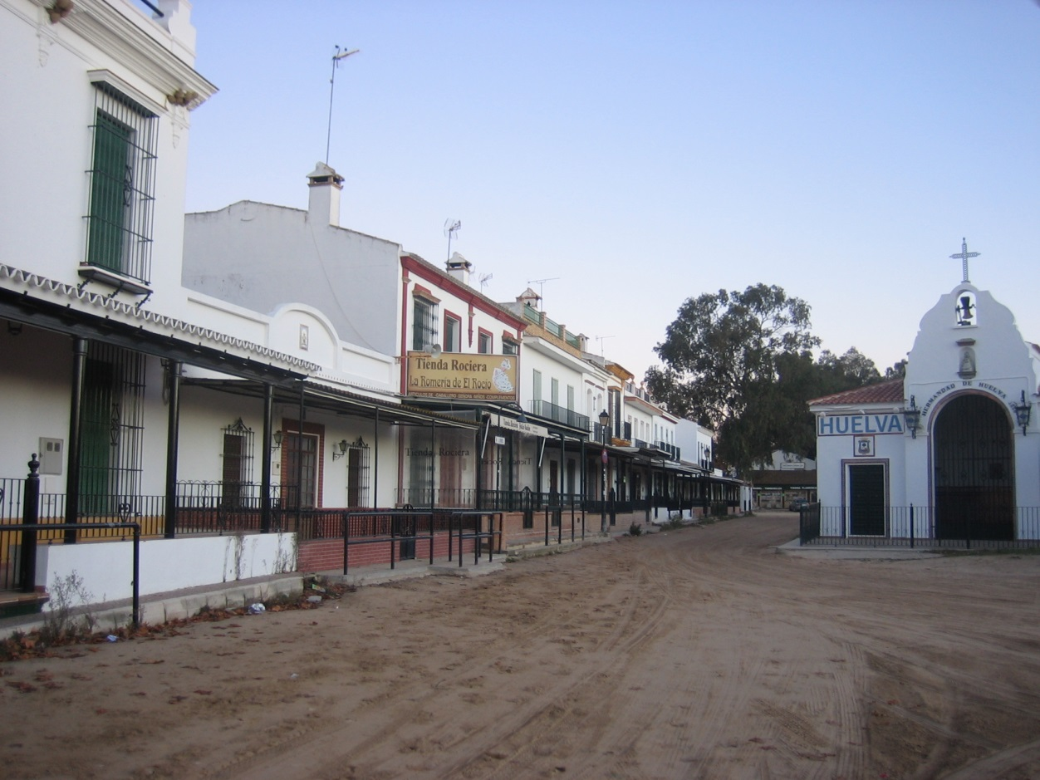
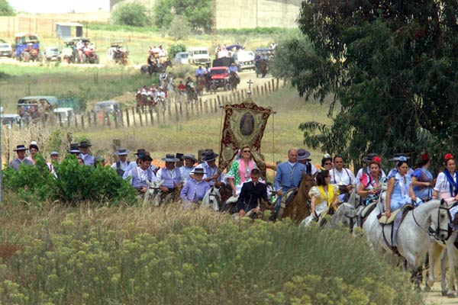
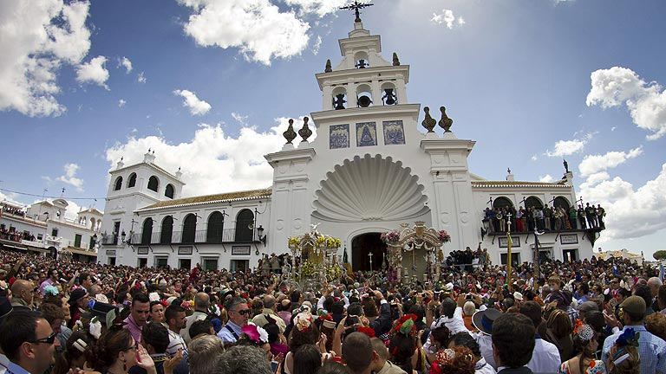

Slide 34
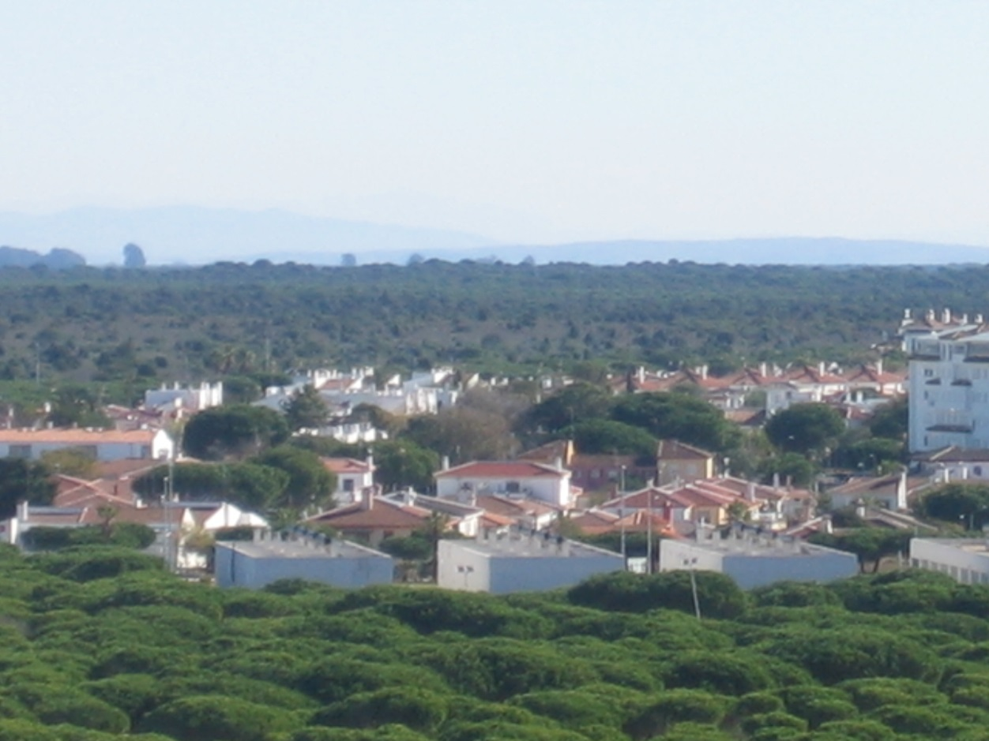
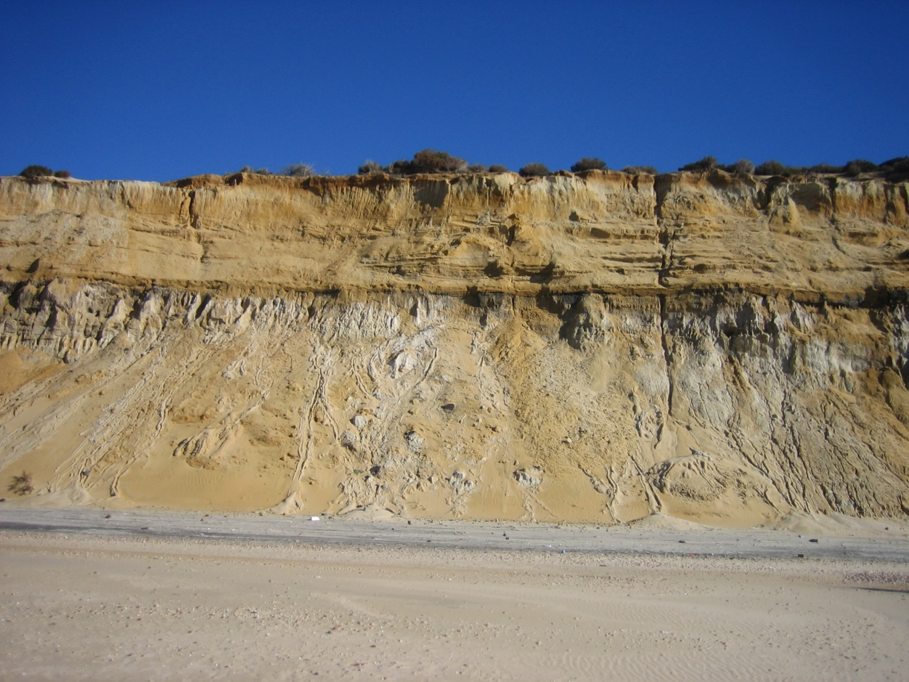
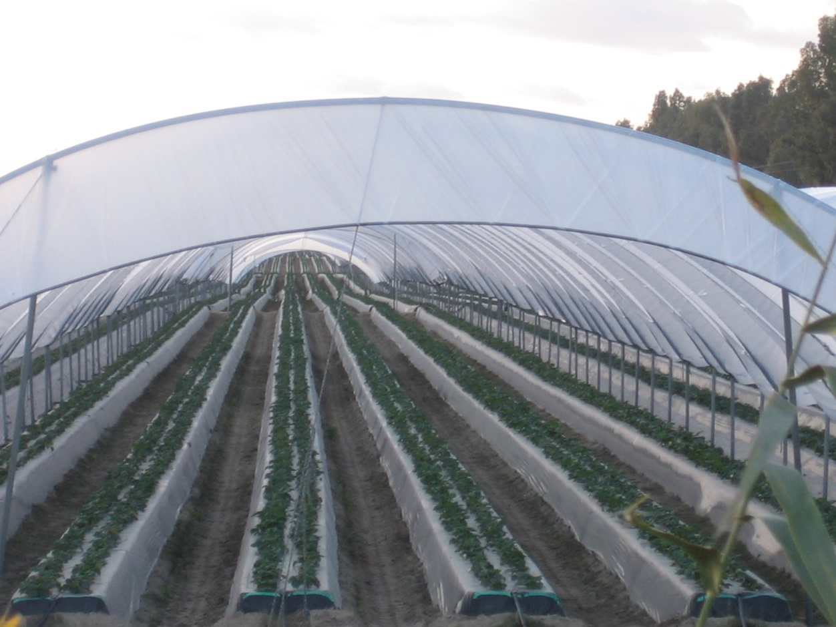
Values… and issues
NP
Intensive agriculture
Erosion
Urbanization

Slide 35
Md
The model attempts at answering questions like…
What if…? – Story lines / scenarios
On land use changes:
Increase or reduction of some uses
Change patterns
Inter-relations among land use classes

Slide 36
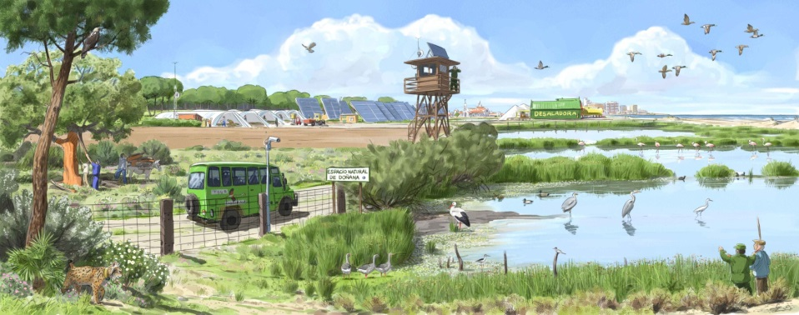
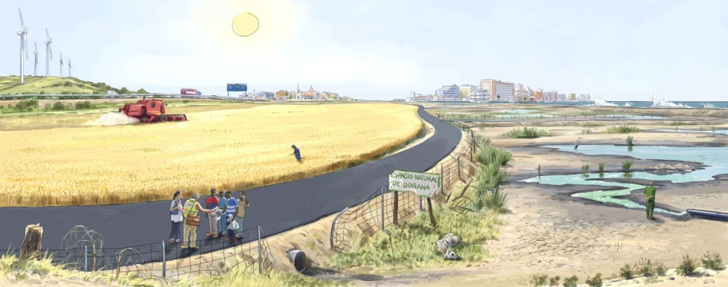
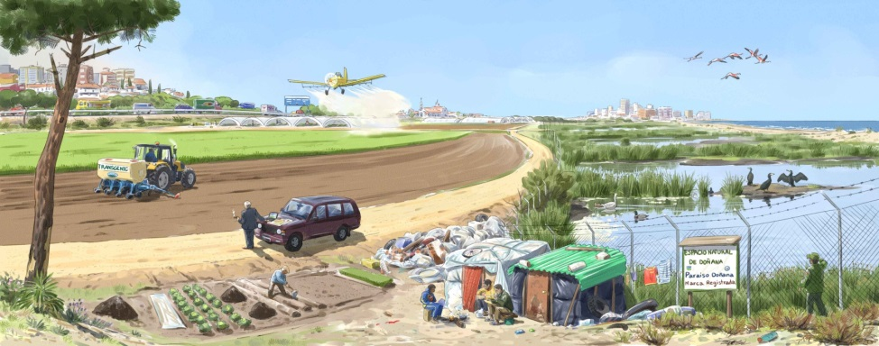
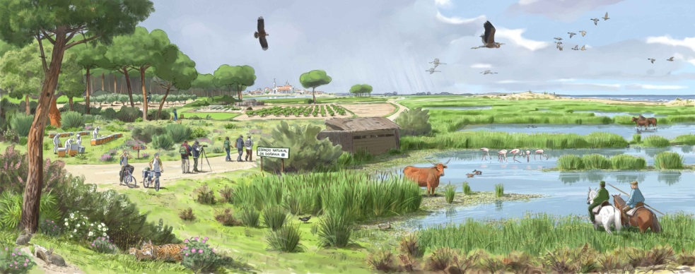
Md
What’s the future we want?
Scenarios
Scenario 1 – “Shared knowledge”
Main driver: Technology
Scenario 3 – “Dry Doñana”
Main driver: Climate change
Scenario 2 – “Doñana trade mark”
Main driver: Globalisation
Scenario 4 – “Adaptive Doñana”
Main driver: Awareness

Slide 37
Md
How does it work?
Cells – typically 100*100 m
States – land use classes
Transition rules
Transition potential depends on accessibility zoning, neighbourhood effect, suitability and stochasticity
Land use claims

Slide 38
Md
Input data
Land use – at least two dates of analog data
Transport network – relevant road, rail, river…
Zoning – relevant land use plans for each land use category
Suitability – relevant biophysical info for each land use category (ie altitude, slope, soils, rainfall…)
Statistics – work force, demographic and economic trends…

Slide 39
Md
Output data
Land use – final simulation date (20-30 years ahead)
Statistics
Derived cartography
Derived indicators

Slide 40
Md
Issues and limitations
Data availability and data quality
Calibration
False expectations

Slide 41
P
Stakeholders’ role vs scientists’ approach
Different interests
Research
Policy making and management
Different capacities
Know how
Know what
Cooperation is a must if the model is to be used

Slide 42
P
Why participatory modelling?
Analytical / technical domain
Discursive / participatory domain
Knowledge of:
- Modelling tools
- Methodologies
- Land use change
(pattern and quality)
Knowledge of:
- Study area
- Local land use
conflicts
- Planning actions
Calibration

Slide 43
Md
Human interaction is key to land use
CA-based participatory modelling

Slide 44
P
Why participatory modelling?
Policy makers who are actively involved in model development are likely to find model outcomes, such as planning recommendations or environmental indicators derived from future land use scenarios difficult to reject (Voinov and Bousquet 2010)

Slide 45
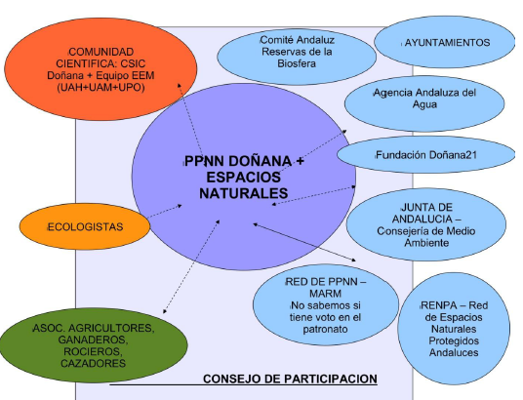
Workshops participants
Managers
Local councils
Farmers
Cattle ranchers
Pilgrims associations
Environmentalists
Scientists
Government officials

Slide 46
Participants’ contribution
Defining study area – Guadiamar river bassin
Selecting data sets – Andalucía (from 1956 to 2007)
Grouping land use classes
Assisting on land use dynamics understanding
Assisting on suitability composite maps
Scenario development
Results and process evaluation

Slide 47
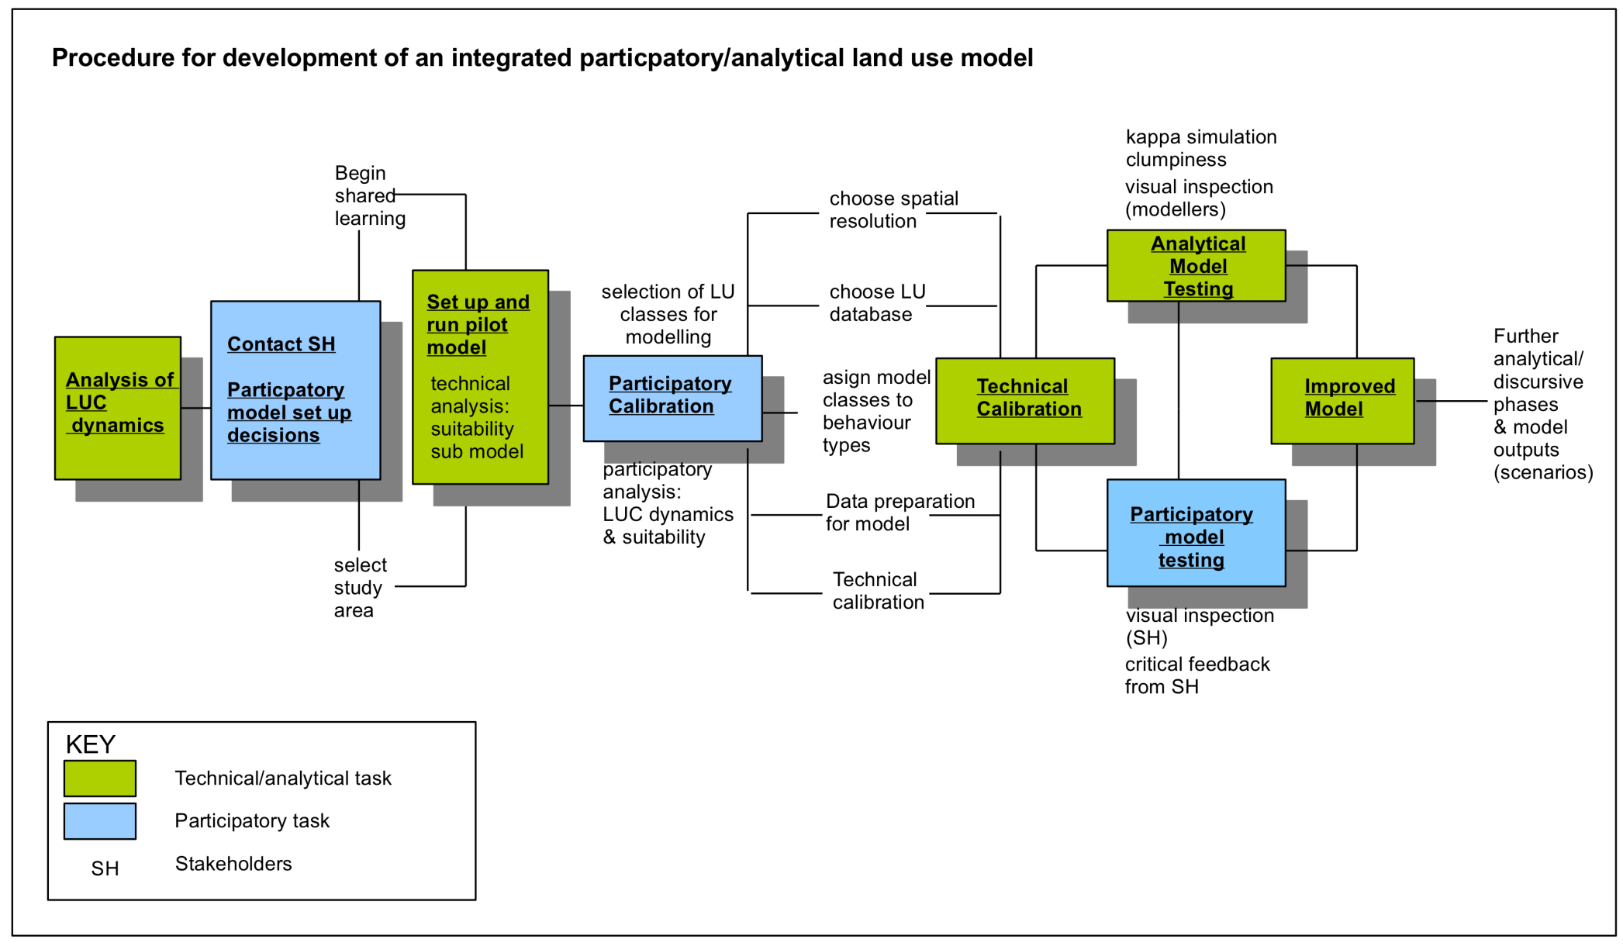

Slide 48
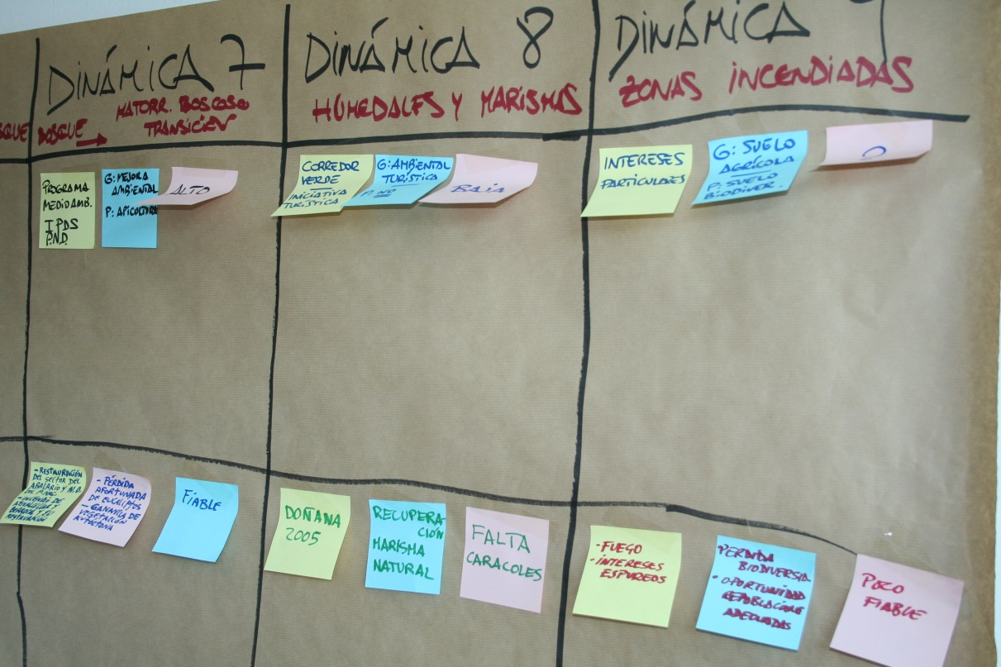
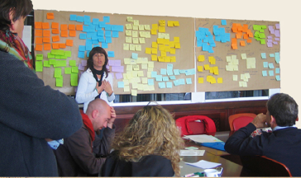
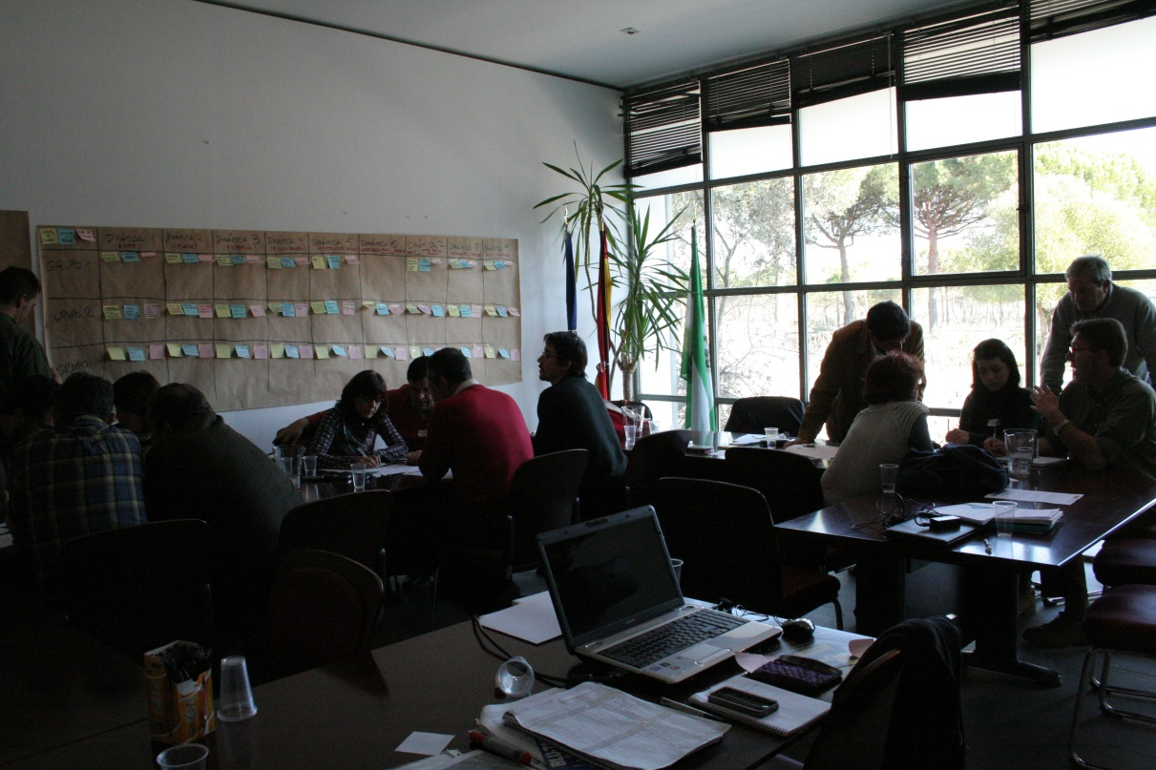
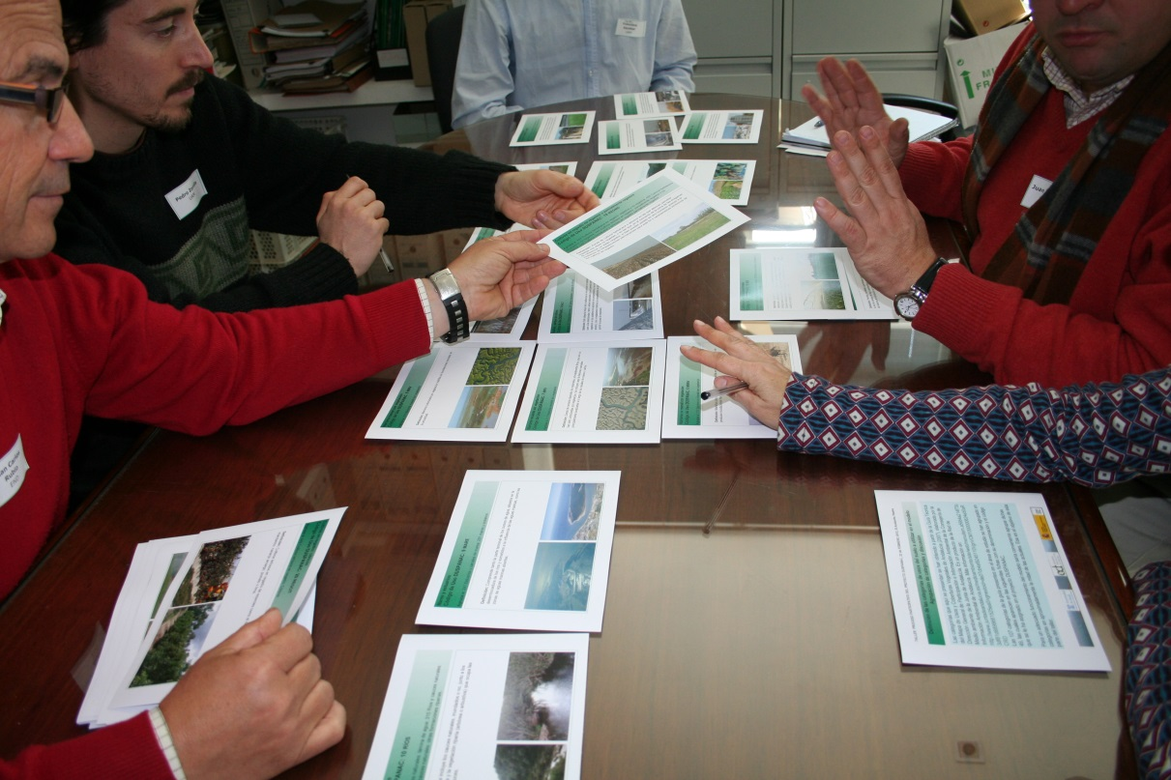
Three workshops, nine activities at Doñana
P

Slide 49
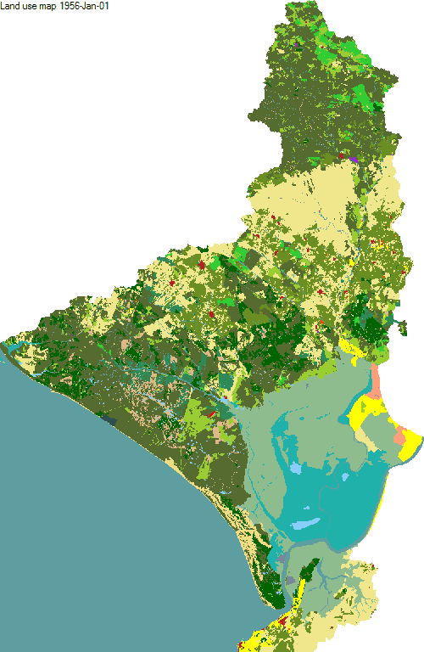
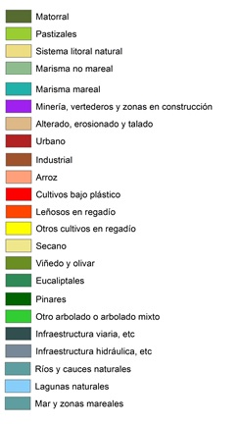
1957-1999 simulation

Slide 50
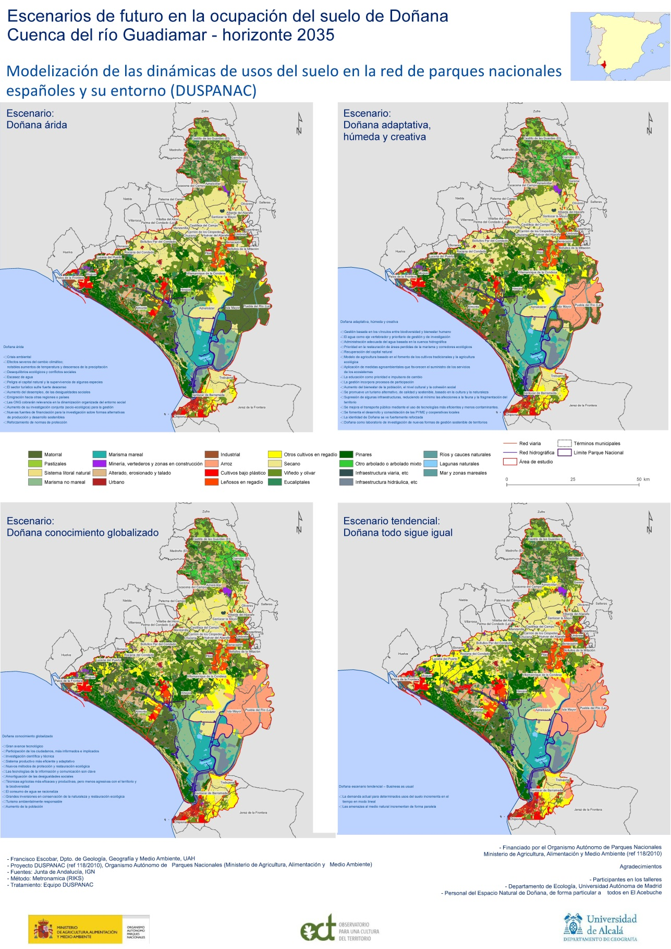
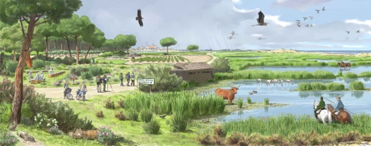
Results

Slide 51
Readings
Hewitt, R., van Delden, H. and Escobar, F., 2014, Participatory land use modelling, pathways to an integrated approach, Environmental Modelling & Software, 52, pp. 149-165.
Escobar, F, Hewitt, R and Hernandez, V, 2014, Usos del suelo en los parques nacionales españoles. evolución y modelado participativo, Madrid, Ministerio de Agricultura y Medio Ambiente, 79 p.
Hewitt, R., Hernández, V., Encinas, M., and Escobar, F., 2012, Land use modelling and the role of stakeholders in natural protected areas: the case of Doñana, Spain. 2012 International Congress on Environmental Modelling and Software. Managing Resources of a Limited Planet, Sixth Biennial Meeting, Leipzig, Germany.
Hewitt, R. Hernández, V. and Escobar, F., 2012, Agentes, escenarios y autómatas celulares; modelización espacial para la toma de decisiones en Doñana y su entorno. XV Congreso Nacional de Tecnologías de la Información Geográfica, Madrid, AGE-CSIC, 19-21 de Septiembre de 2012, 10 pp.
Hewitt, R. and Escobar, F., 2010, The territorial dynamics of fast-growing regions: Unsustainable land use change and future policy challenges in Madrid, Spain, Applied Geography 31 (2010,) 650-667.

Slide 52
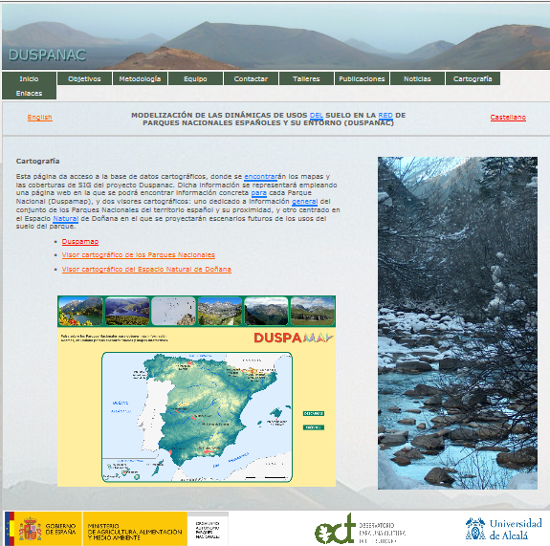
www.geogra.uah.es/duspanac
Data
Publications
PPT presentations
Multimedia
Workshops docs
News
Maps
Tutorials
Contact

